Slide 1

Sales Data Processing for Retail Optimization
Placement Assessment for Cloud Data Engineer Role
Justin Ziv Patil (2347122)
19/11/2024

Slide 2
Table of Contents
Design Document
Code Implementation
Dataset Documentation
Power BI Dashboard
Azure Workflow Screenshots

Slide 3
Solution Overview
Objective: Sales Data Processing for Retail Optimization
Client: XYZ Retail Inc.
Overview:
Ingest, process, and visualize raw sales data.
Insights for optimizing retail operations.

Slide 4
High-Level Design
Tools and Storage:
Data Ingestion: Azure Data Factory
Storage: Azure Data Lake Storage (ADLS) Gen2
Processing: Data cleaning , Filtering and Transforming
Visualization: Power BI
Architecture Highlights:
Scalability, cost-efficiency, big data analytics support, and flexible schema.

Slide 5
System Architecture
Ingestion: Sales data in CSV format to ADLS via Azure Data Factory.
Storage: Raw and processed data stored in ADLS.
Transformation: Data is successfully transformed
Visualization: Real-time dashboards in Power BI.
Diagram: Added an architecture diagram to showcase the above flow.

Slide 6
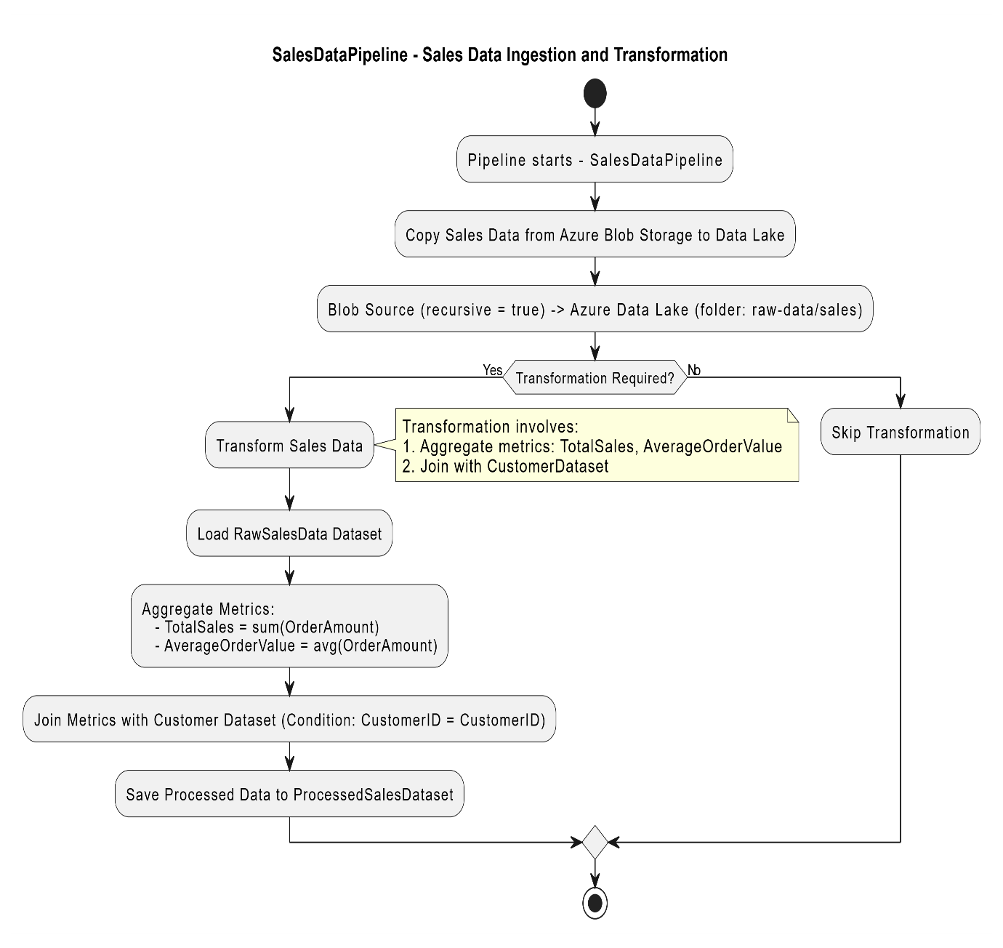
The SalesDataPipeline is designed to efficiently process and transform sales data. It begins by copying data from Azure Blob Storage to Azure Data Lake, ensuring all files in the specified folder (raw-data/sales) are included using recursive reading. Next, the pipeline checks if data transformation is required. If transformation is needed, it computes key metrics such as Total Sales (sum of order amounts) and Average Order Value (average of order amounts) and integrates this data with customer details by joining it with the CustomerDataset using CustomerID as the key. The raw sales data is first loaded, metrics are aggregated, and the enriched dataset is stored as the ProcessedSalesDataset. If no transformation is needed, the pipeline skips this step and moves forward. The process ends after saving the processed or untransformed data, completing the data ingestion and transformation workflow.

Slide 7
Choice Of Data Storage
Justification for Azure Data Lake Storage:
Scalability: Supports large datasets and integrates with Azure tools.
Cost-Effective: Pay-as-you-go pricing model.
Security: Robust role-based access control (RBAC).
Advantages of Azure Data Lake Storage Gen2:
Hierarchical namespace for easy organization.
Tiered storage for optimized cost.
Fine-grained access control and integration with big data tools.

Slide 8
Code Implementation
Purpose: Data pipeline using PySpark for processing and anonymization.
Key Steps:
Load raw data.
Validate schema and handle missing values.
Calculate Total_Sales.
Aggregate metrics by location.
Anonymize sensitive data (e.g., credit card numbers).

Slide 9
Handling PII Data
Techniques:
SHA-256 hashing for sensitive fields.
Regular expression masking for phone numbers.
Dropped unneeded sensitive fields post-encryption.

Slide 10
Dataset Documentation
Structure:
Columns: OrderID, CustomerName, PhoneNumber, Location, Quantity, etc.
Types: String, Integer, Float, Date.
Preprocessing Steps:
Schema validation, missing value handling, data transformation.
Anonymization and data enrichment.

Slide 11
Azure Workflow
Resource Setup:
Resource group and storage account in Azure.
Enable hierarchical namespace in ADLS.
Ingestion:
CSV upload to ADLS.
Data Factory for pipeline automation and validation.
Error Handling: Transformations applied during pipeline setup.

Slide 12
Power BI Dashboard Insights
Overview: Real-time insights on sales, products, and customers.
Pages:
Sales Overview: Line and bar charts.
Product Performance: Distribution insights by location and category.
Customer Insights: High-value customers and geographic trends.

Slide 13
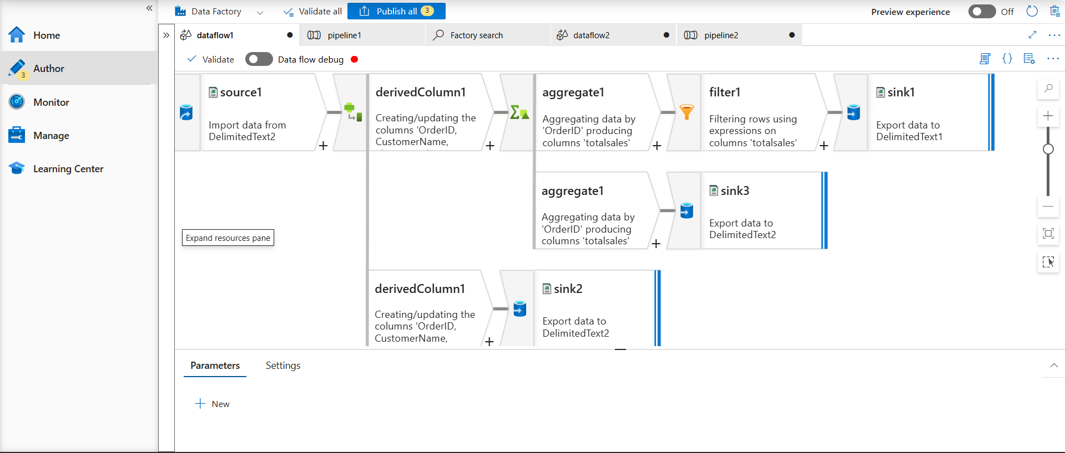
Pipeline Dataflow

Slide 14
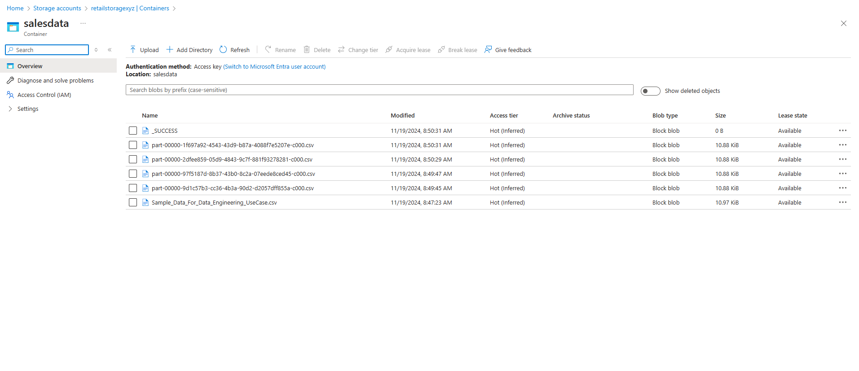
The Saved CSV Files are in Azure DataLake Storage

Slide 15
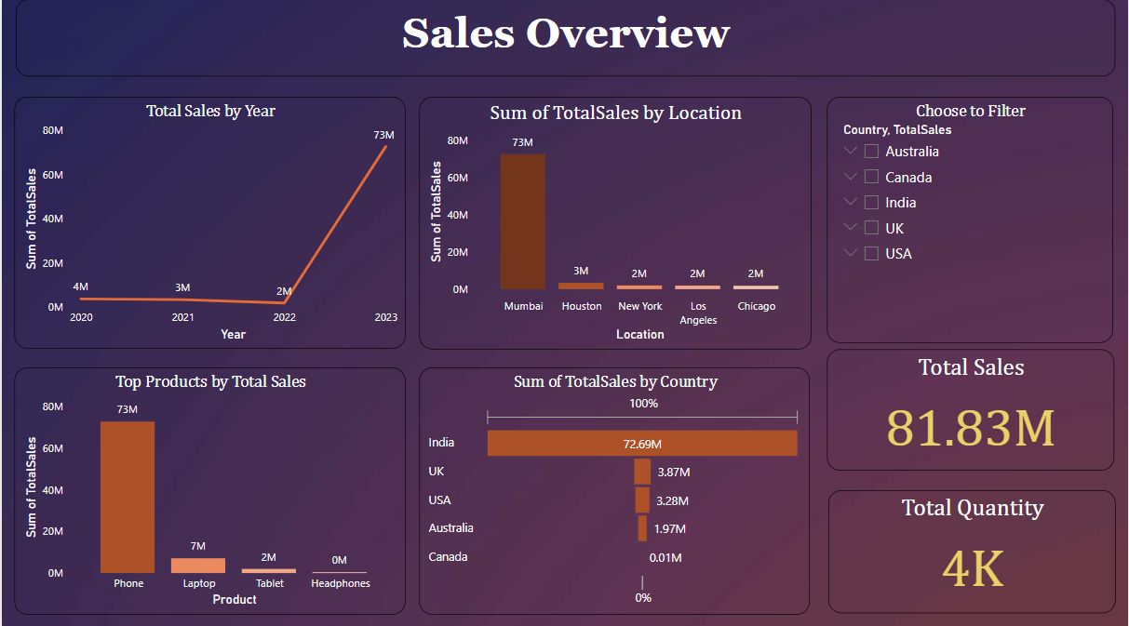
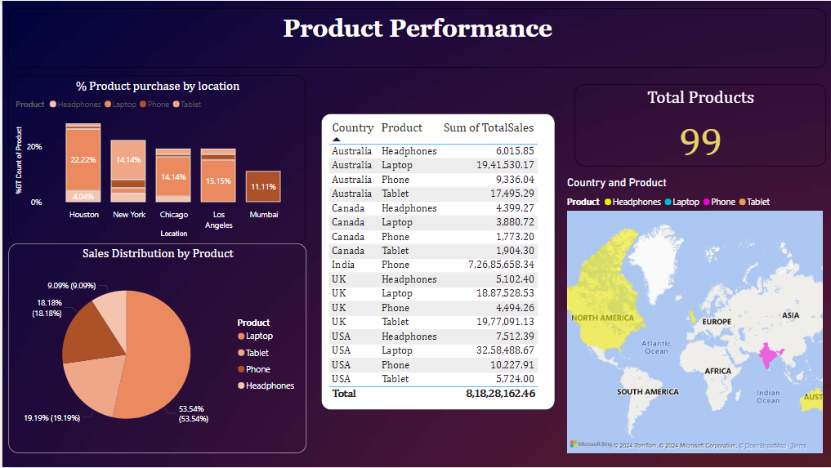
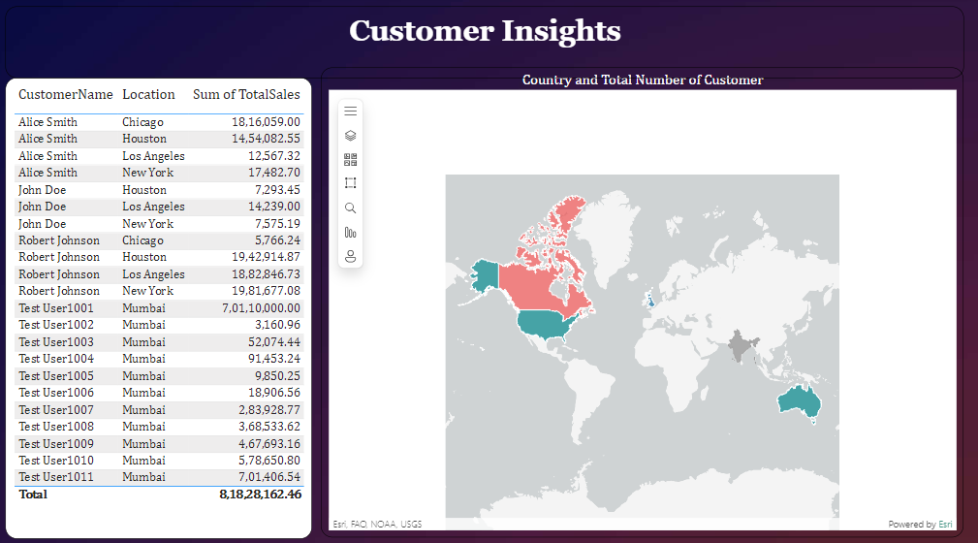
Power BI Dashboard

Slide 16
Yearly Sales Growth:
Total sales show a significant spike in 2023, reaching 73M,
indicating a strong upward trend compared to previous years.
Location-based Performance:
Mumbai leads with the highest sales of 73M, followed by other
cities like Houston, New York, Los Angeles, and Chicago, each
contributing relatively smaller amounts.
Top-performing Products:
Phones dominate the product category with the highest sales of
73M, while laptops, tablets, and headphones show minimal
Contributions
Country-wise Sales Distribution:
India accounts for the largest share of sales (72.65M),
far outpacing other countries such as the UK, USA, Australia,
and Canada
Overall Sales and Quantity:
Dashboard highlights Total Sales of 81.83M and a Total Quantity
of 4K,reflecting strong market performance & product demand
Sales Overview

Slide 17
Top-selling Product: Phones account for the majority of sales
with 51.5%, followed by laptops at 19.1%.
Regional Product Insights: Houston leads with 22.2%
of product purchases, followed by New York and Chicago
Country-wise Sales: India dominates the total sales
with 72.65M, significantly higher than other countries like
the UK and USA
Total Products Overview: A total of 99 products are
tracked across categories, showcasing diverse
customer preferences.
Geographic Visualization: The map highlights strong
sales distribution across Asia, particularly India,
with notable contributions from other regions.
Product Perfomance

Slide 18
Top Customer Locations: Chicago and Houston lead in
total sales, with Alice Smith contributing significantly to
sales in both locations.
Key Customers: Alice Smith and Robert Johnson are
major contributors to sales across multiple locations,
driving a substantial portion of the revenue.
Regional Sales Distribution: The map highlights strong
customer presence and sales activity in North America,
with additional contributions from Australia and Asia.
Mumbai Dominance: A large number of customers and
consistent sales are observed in Mumbai, primarily from
Test Users.
Total Sales Overview: The combined customer sales
amount to ₹81,28,28,162.46, showcasing the significance
of key customers and their geographic spread.
Customer Insights

Slide 19
Results and Learnings
Outcome:
Successful pipeline and dashboard implementation.
Key metrics like Total_Sales and Average_Order_Value.
Real-time decision-making enabled through dashboards.
Challenges:
Handling empty spaces in data.
Ensuring error-free transformation processes.

Slide 20

Thank you
Justin Ziv Patil
Justin.zivpatil@mca.christuniversity.in
​​

